Slide 1
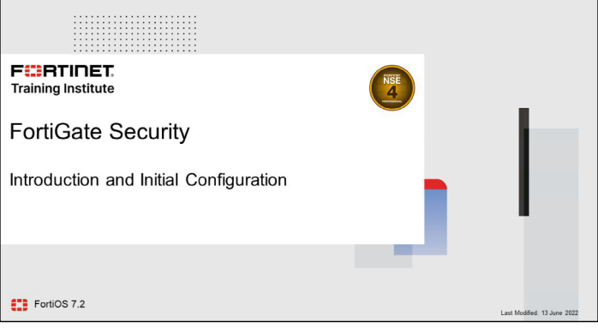
Notes:
https://www.fortinet.com/training-certification

Slide 2
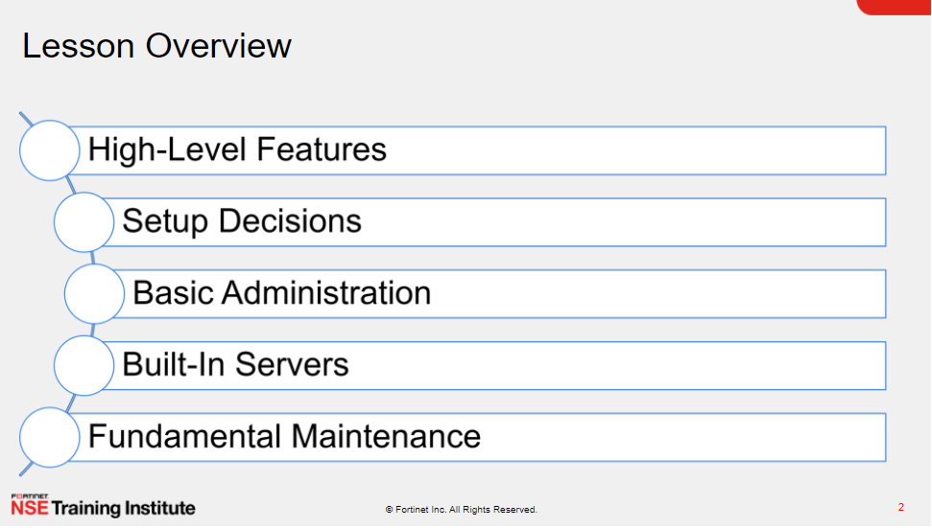

Slide 3
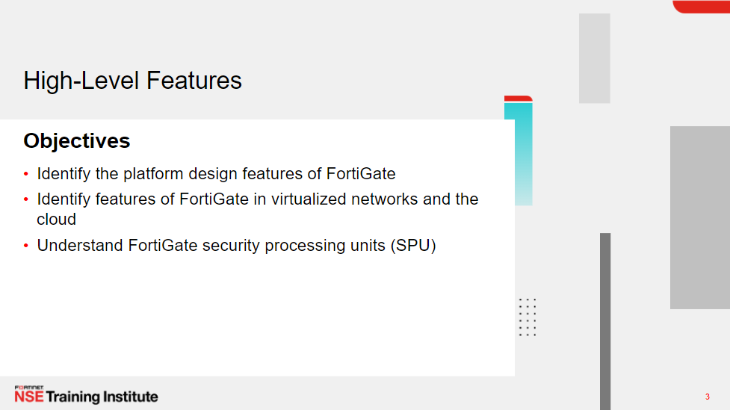
https://www.fortinet.com/products/fortigate/fortiasic
Notes:
https://www.fortinet.com/products/fortigate/fortiasic

Slide 4
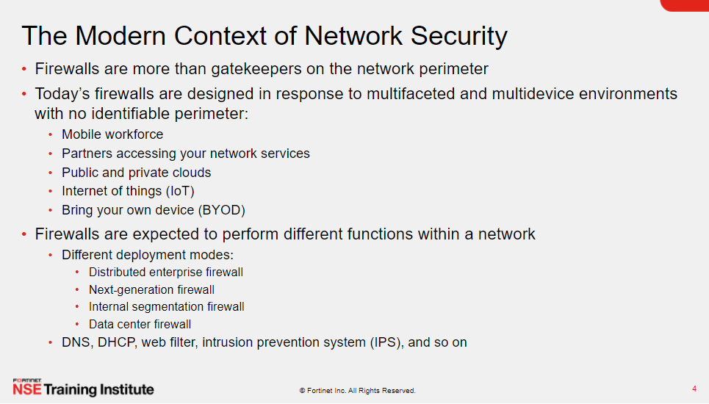
Notes:
Zero Trust

Slide 5
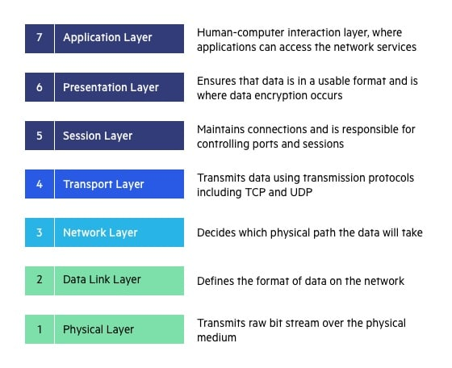
History OF Firewall
The Seven Layers of the OSI Model are:
Application Layer
Presentation Layer
Session Layer
Transport Layer
Network Layer
Data Link Layer
Physical Layer
Notes:
https://www.thepcinsider.com/who-invented-firewall-history-evolution-types-generations/

Slide 6
History OF Firewall
Evolution, History, Types, and Generations of the various Firewall Technologies
1988 – First Generation – Packet-Filter Firewall (Stateless Firewalls)
This type of firewall does not look at the connection state of the packet. Thus, it doesn’t maintain a state
1989 – Second Generation – Stateful Firewall
A Stateful Firewall keeps information about the active sessions and connection states; it records all connections passing through it.
1991 – Third Generation – Application Layer Firewall
2004 – IDC coins the term Unified Threat Management (UTM)
It is the evolution of the traditional firewall into a comprehensive network security solution. A UTM uses technologies such as Network Firewall, Web Filtering, Gateway Antivirus, Intrusion Prevention System (IPS), Anti-Spam, VPN, etc. to protect networks from threats.
2009 – Gartner defines the Next-Generation Firewall (NGFW)
Notes:
https://www.thepcinsider.com/who-invented-firewall-history-evolution-types-generations/

Slide 7
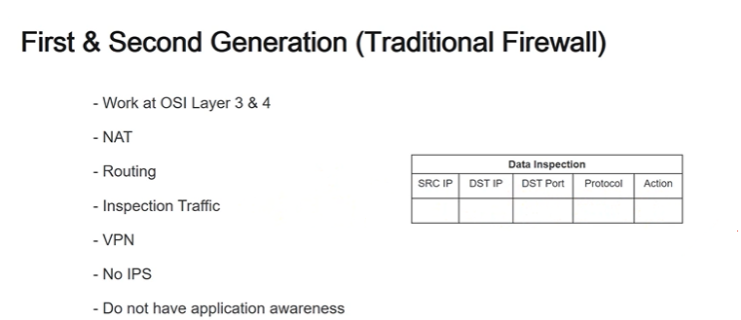
History OF Firewall
Notes:
https://www.thepcinsider.com/who-invented-firewall-history-evolution-types-generations/

Slide 8
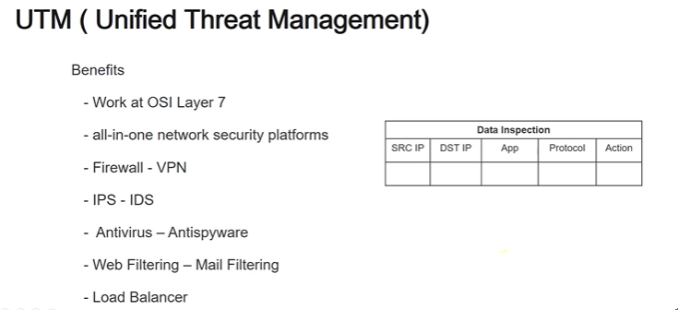
History OF Firewall
Notes:
https://www.thepcinsider.com/who-invented-firewall-history-evolution-types-generations/

Slide 9
UTM vs NGFW
UTM are usually bundled feature set, NGFW has bundle but licensing can be selective.
a UTM consolidates many security functions (email security, AV, IPS, URL filtering etc.) and is tailored mostly to SMBs in terms of management capabilities, throughput, support, etc.
A NGFW is an enterprise-grade product that at the very least includes IPS capabilities and application awareness (layer 7 control).
At Fortinet, for example, we offer customers the ability to deploy a FortiGate device as a pure firewall, an NGFW (enabling features like Application Control or User- and Device-based policy enforcement) or a full UTM (enabling additional features like gateway AV, WAN optimization, and so forth).
https://www.fortinet.com/support/support-services/fortiguard-security-subscriptions/fortigate-security-bundles
Notes:
https://www.algosec.com/blog/state-of-the-firewall-utm-vs-ngfw/

Slide 10
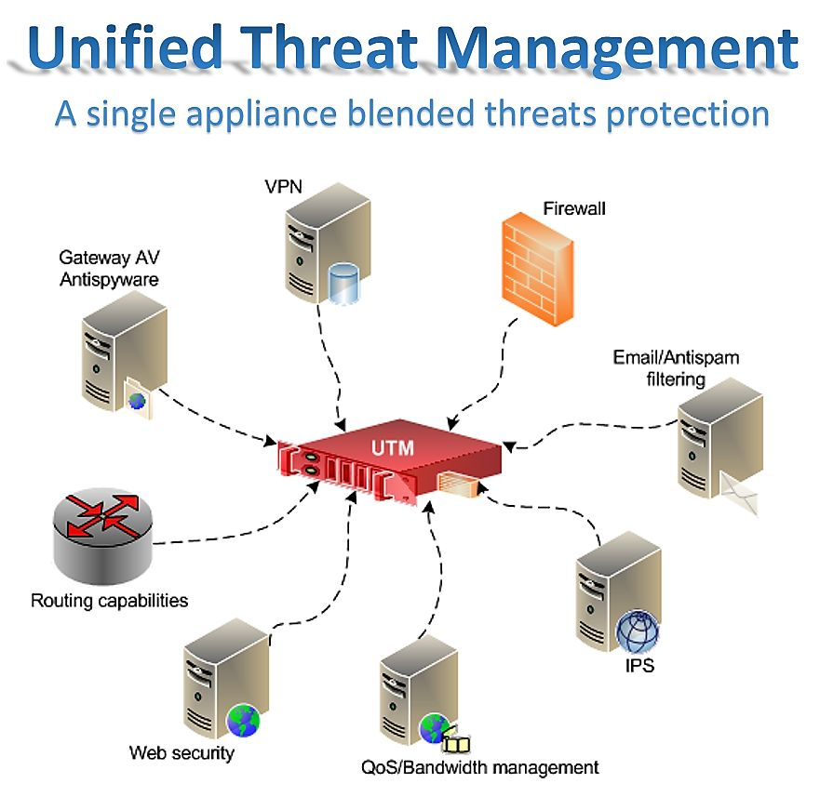
UTM

Slide 11
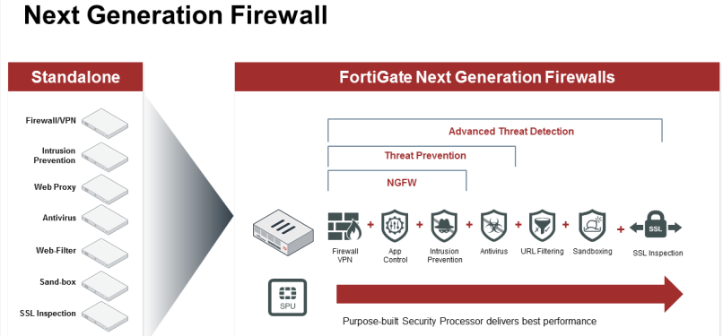
Next-Generation Firewall (NGFW) is the part of the third generation in firewall technology, combining a traditional firewall with other network device filtering functionalities, such as an
application firewall using an in-line deep packet inspection system (DPI), an intrusion prevention system (IPS).

Slide 12
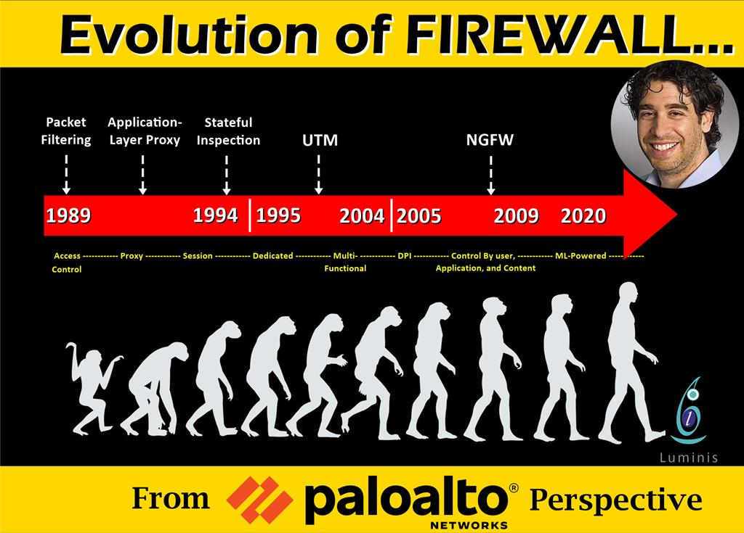

Slide 13
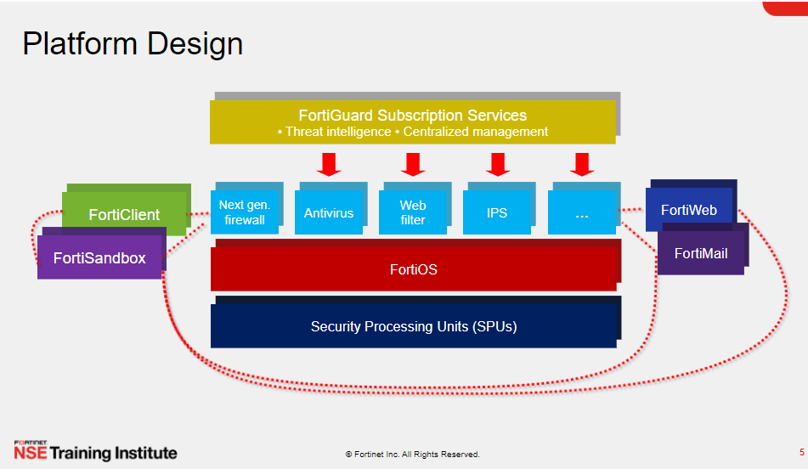

Slide 14
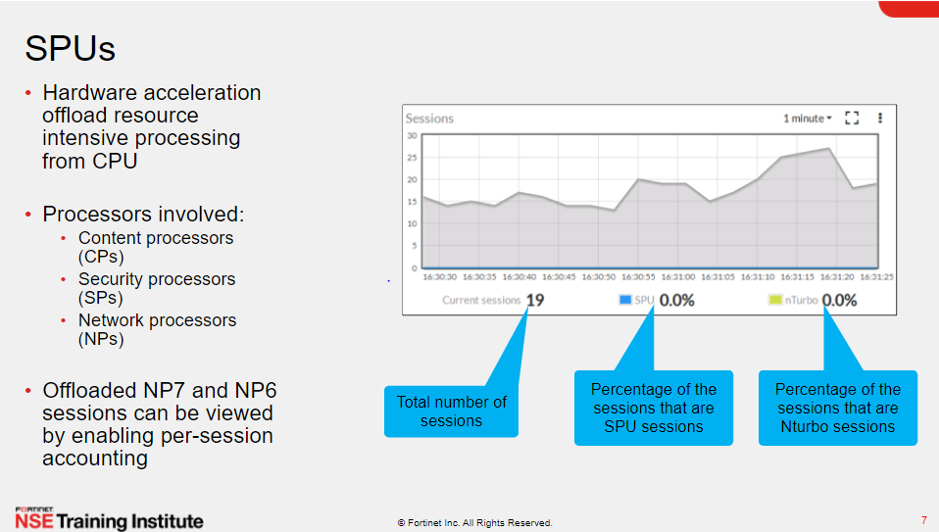

Slide 15
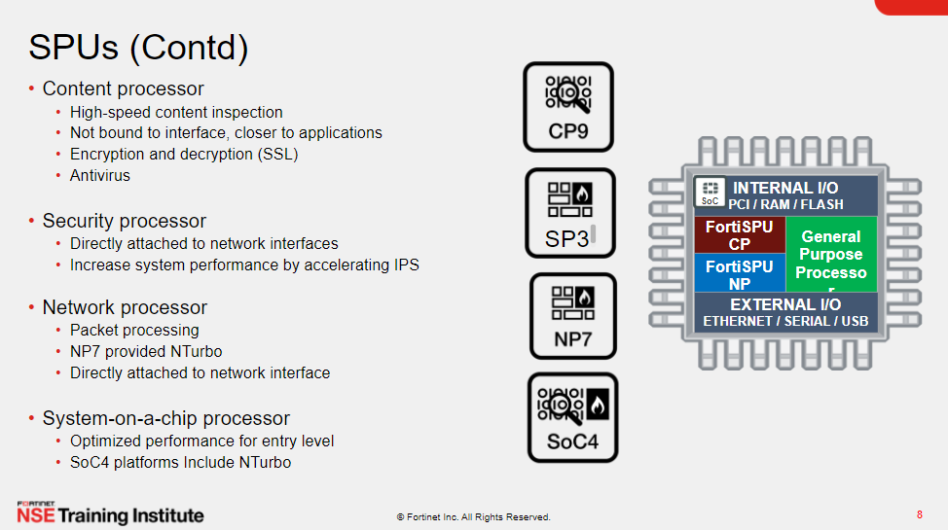
https://www.fortinet.com/products/fortigate/fortiasic

Slide 16
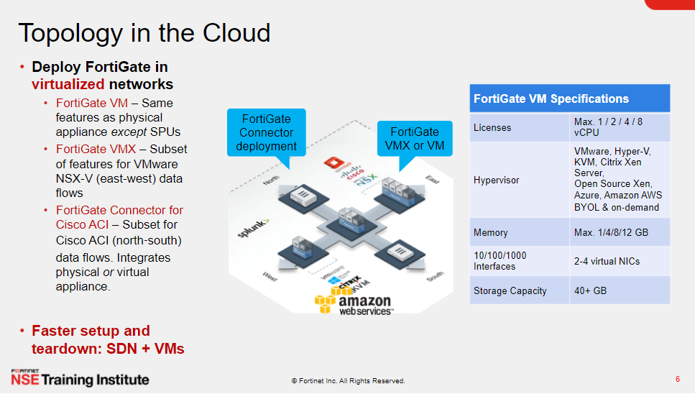

Slide 17
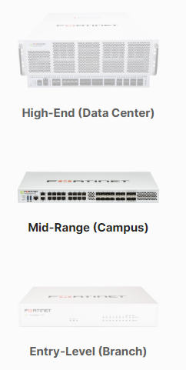
FortiGate Series and Models
https://www.fortinet.com/products/next-generation-firewall

Slide 18
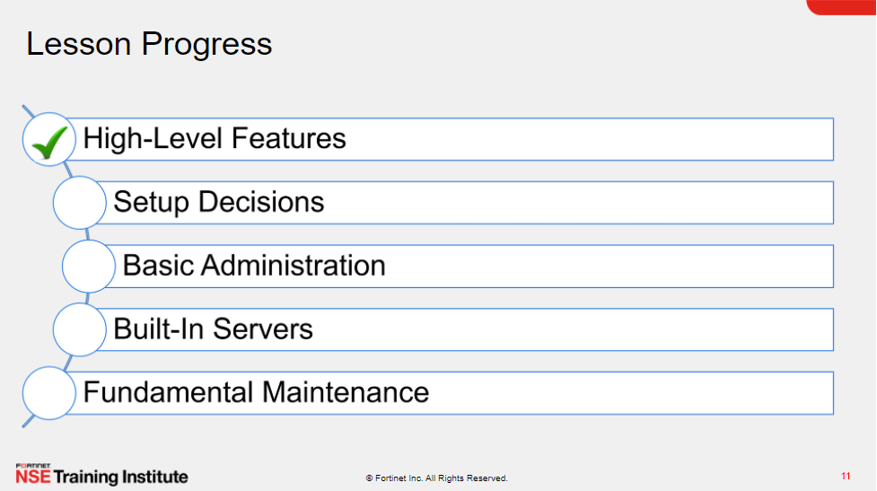

Slide 19
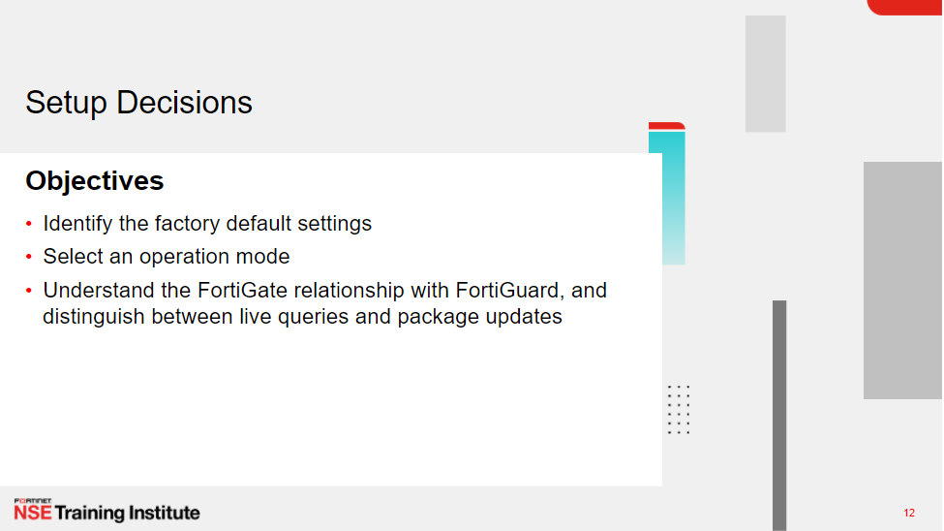

Slide 20
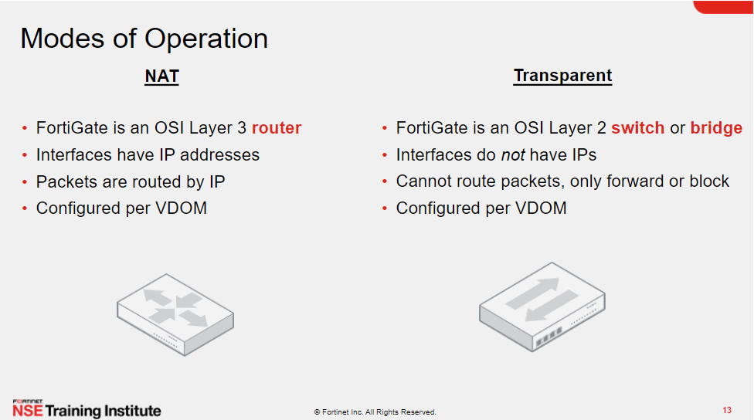
Notes:
Transparent vs Routed

Slide 21
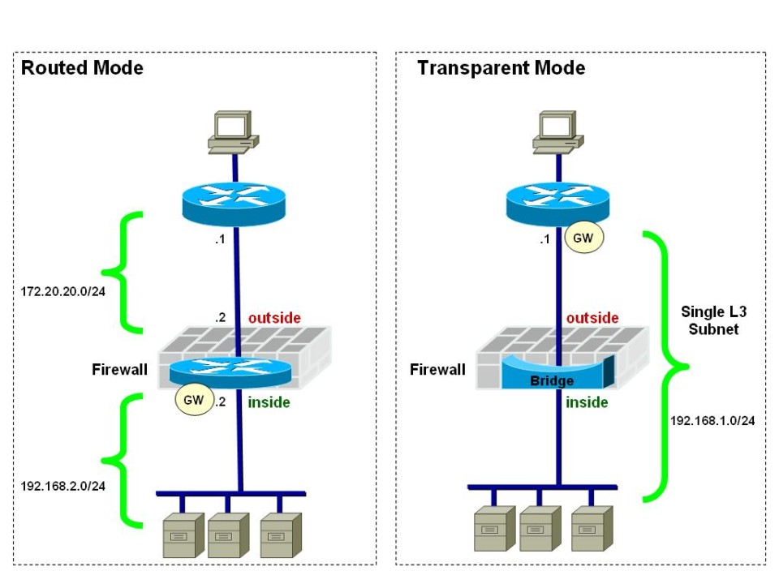
Notes:
Transparent vs Routed

Slide 22
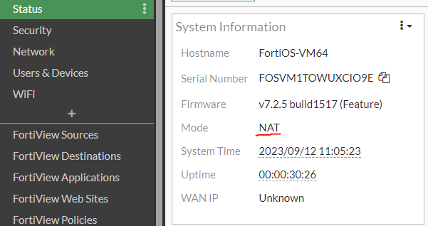
NAT Mode

Slide 23
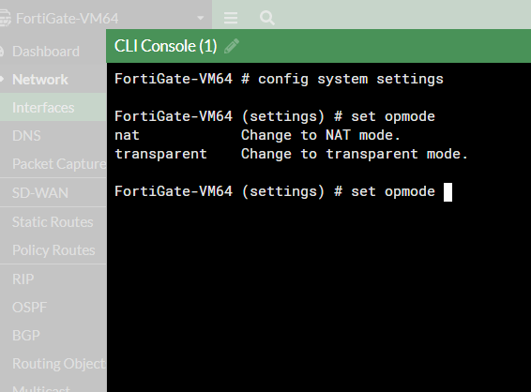
Transparent Mode

Slide 24
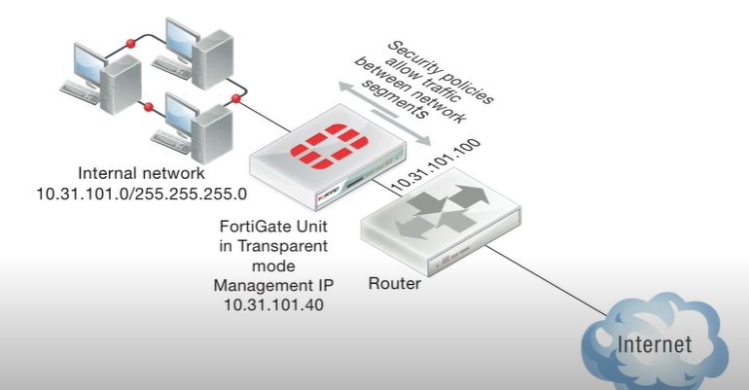
Transparent Mode
config system settings
set opmode transparent
set manageip <address and netmask>
set gateway <address>
end

Slide 25
Transparent Mode
Don’t have IP address
Work as a layer 2 switch
No NAT
No Routing
Inspection traffic until layer 2

Slide 26
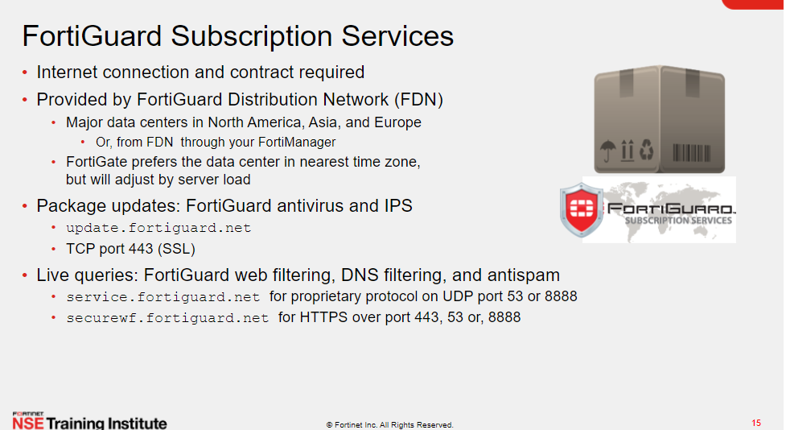

Slide 27
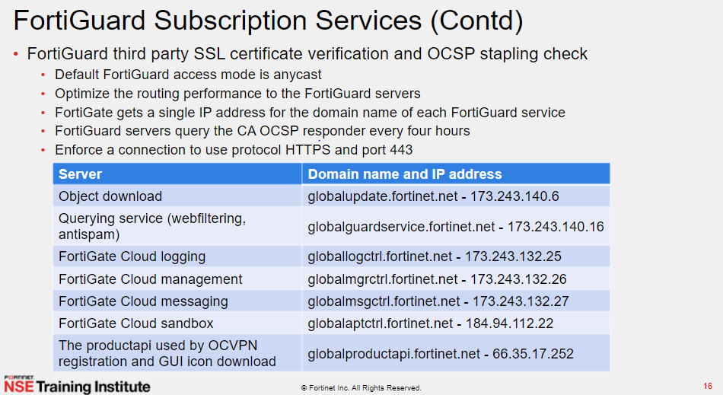

Slide 28
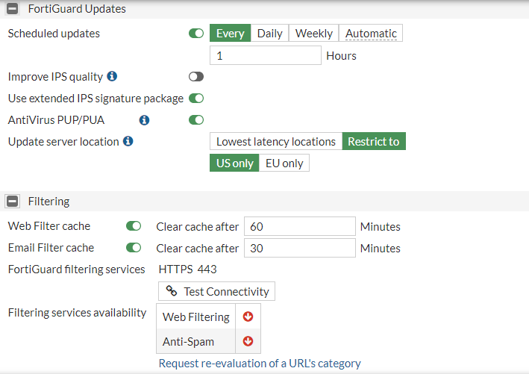
System -- > FortiGuard

Slide 29
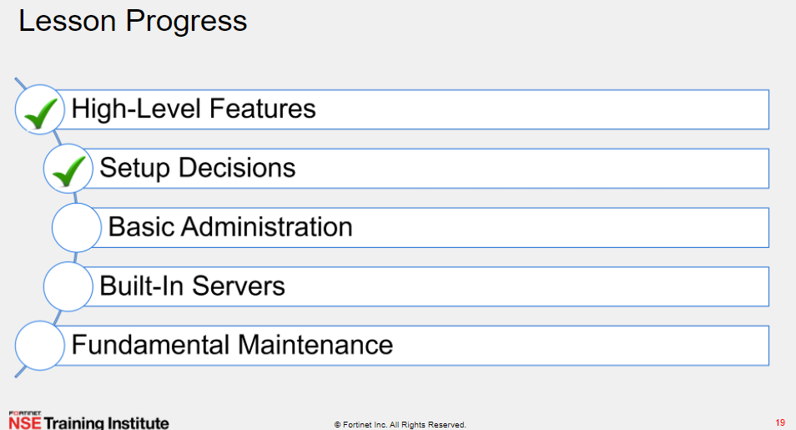

Slide 30
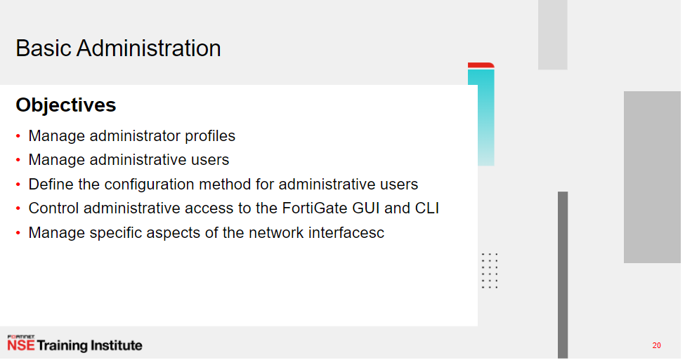

Slide 31
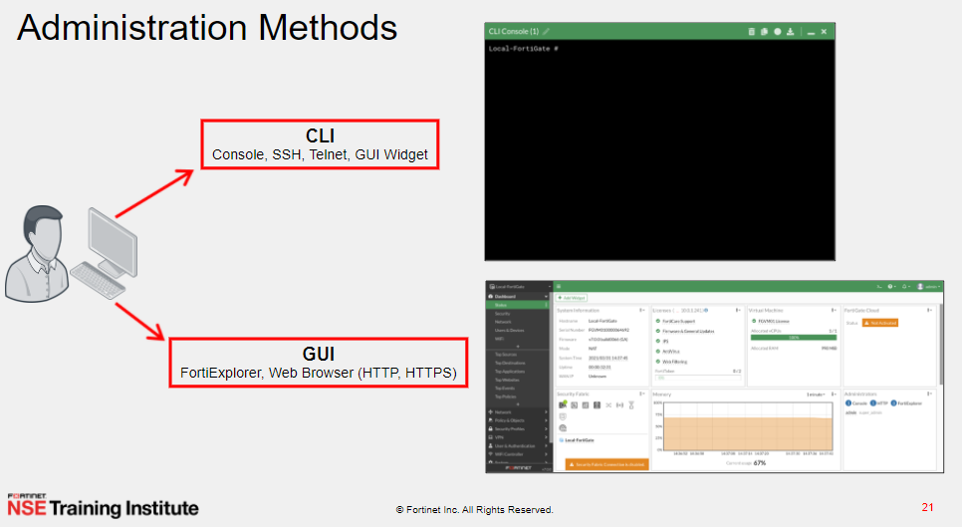

Slide 32
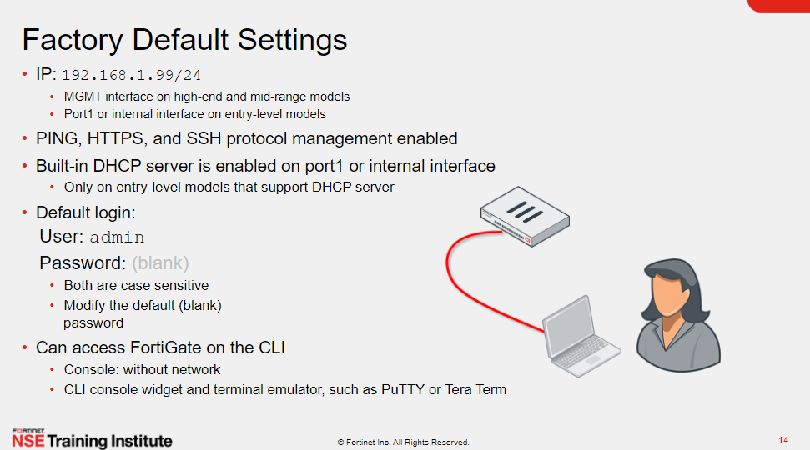
Using GUI

Slide 33

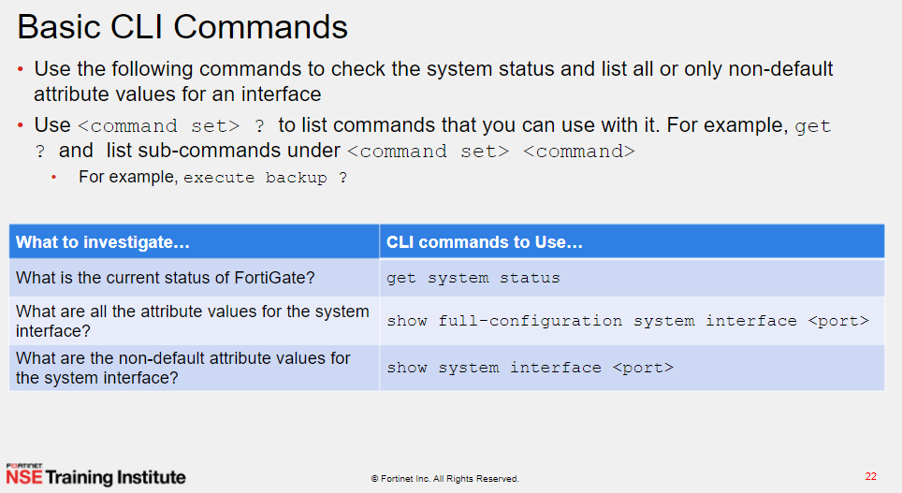
Config : Use the config commands to change your FortiGate's configuration.
Execute : perform immediate operations on the FortiGate unit
- execute ping , traceroute …
- execute reboot , shutdown
- execute ha ..
- execute update-now
Get : get commands retrieve information about the operation and performance of your FortiGate unit
Show :
Diagnose :like Debug in cisco

Slide 34

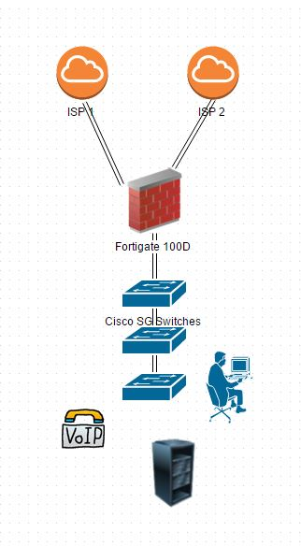
config system interface
edit port1
set ip 192.168.1.99/24
set allowaccess http https ping ssh telnet
end
config system route
edit 1
set device port1
set gateway 192.168.1.1
end

Slide 36
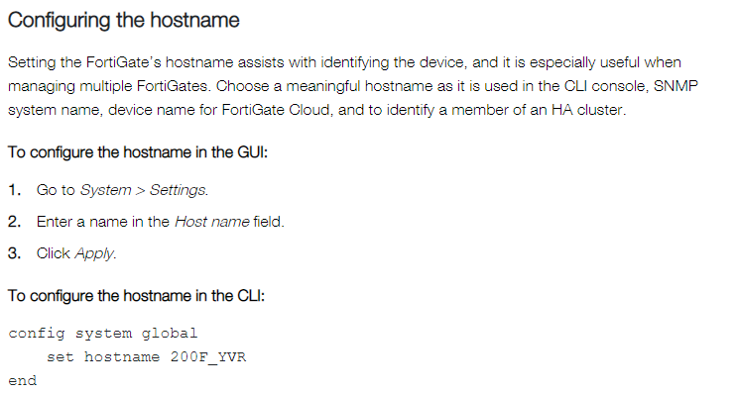

Slide 37
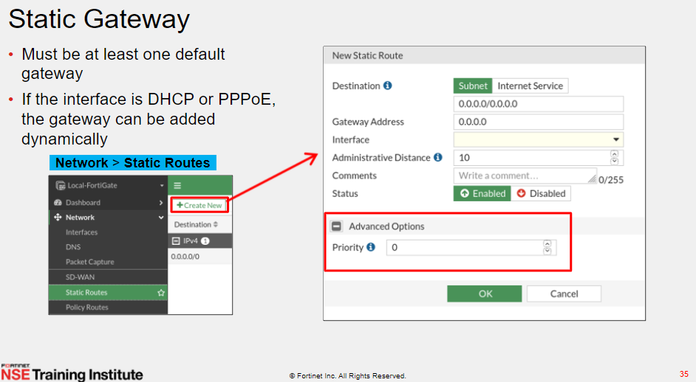

Slide 38
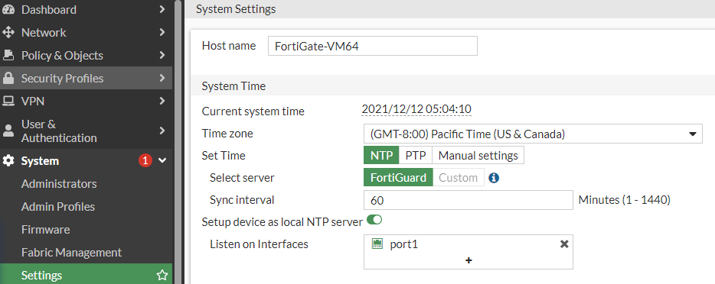
NTP (Network time Protocol) & PTP (Precision time Protocol )
NTP provides millisecond accuracy while PTP provides sub-microsecond accuracy.

Slide 39
NTP (Network time Protocol) & PTP (Precision time Protocol ) (Cont)
NTP server:
config system ntp
set ntpsync enable
Set type custom
config ntpserver
edit 1
set server 192.168.1.1
Setup device as local NTP server
Enable to configure the FortiGate as a local NTP server. This option is not available if Set Time is PTP.
In the Listen on Interfaces field, set the in

Slide 40
DNS
With DNS, FortiGate can connect to the FortiGuard network

Slide 41
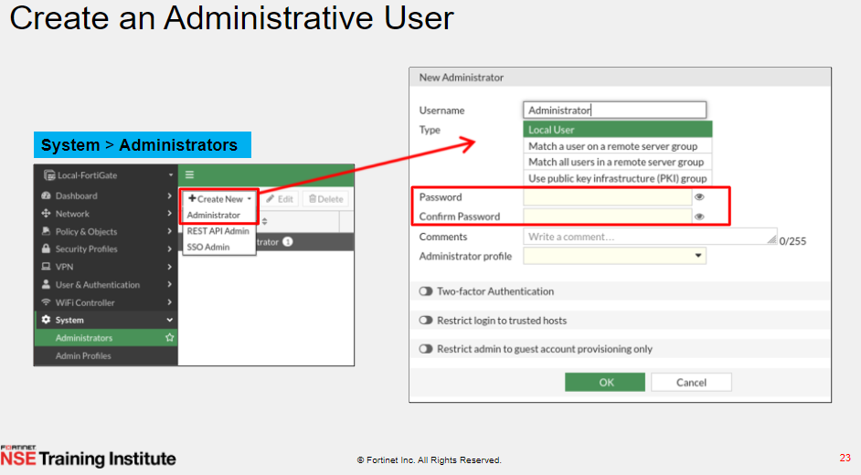

Slide 42
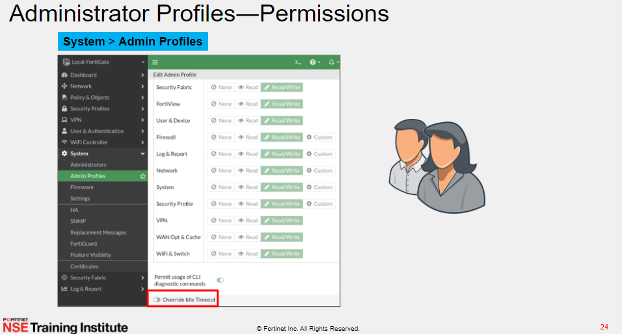

Slide 43
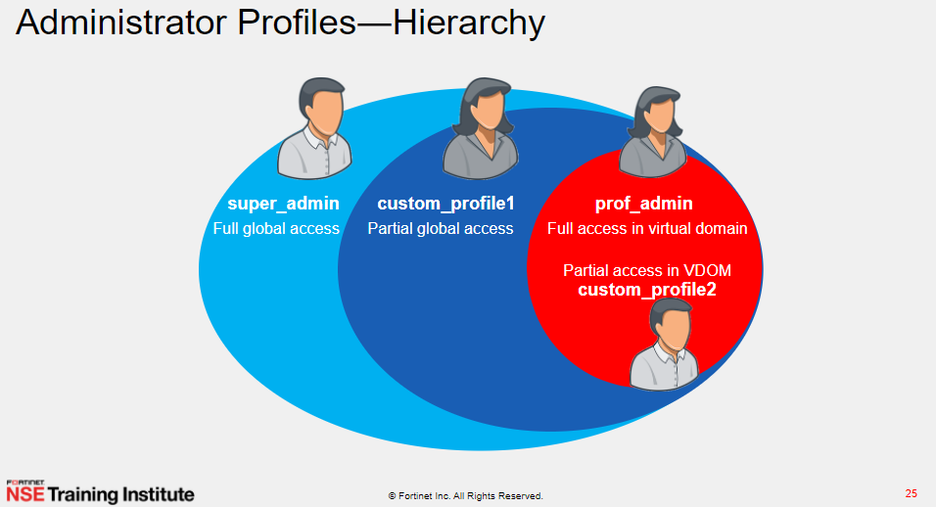

Slide 44
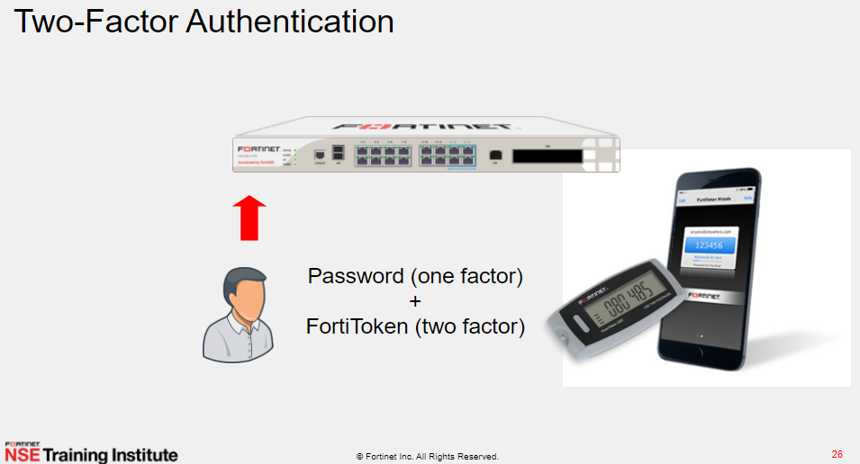

Slide 45
Where to Apply 2FA/MFA
VPN users : SSL/Ipsec
Admin users

Slide 46
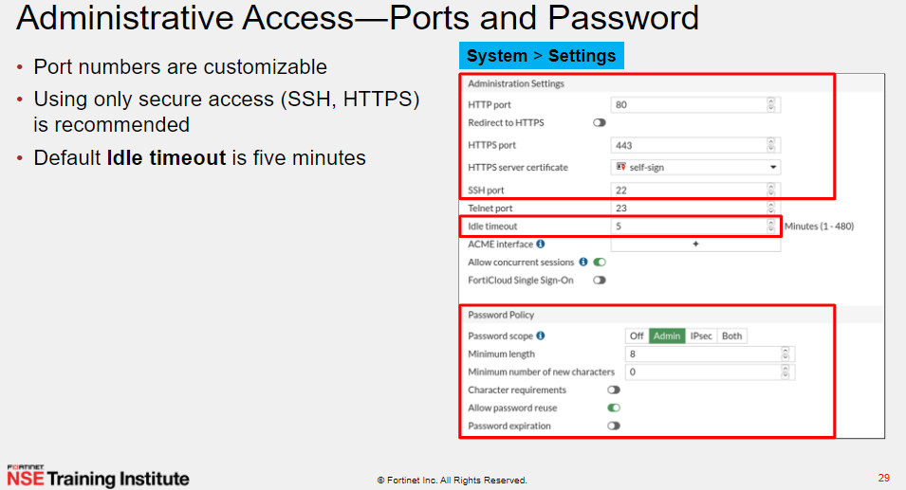

Slide 47
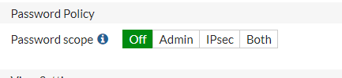
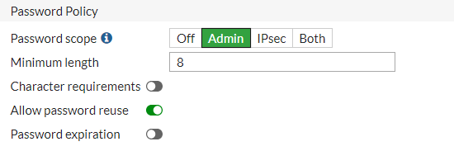
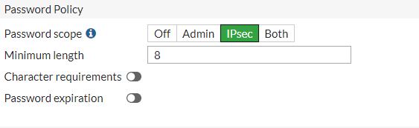

Slide 48
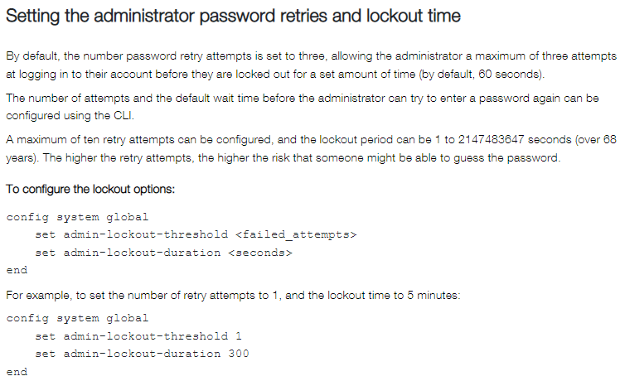

Slide 49
maximum number of logged-in administrators
FGT# config system global FGT(global) # set admin-login-max ? please input integer value (1-100) FGT(global) # set admin-login-max 1 FGT(global) # end

Slide 50
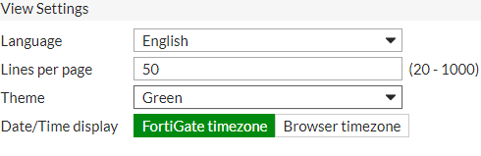

Slide 51
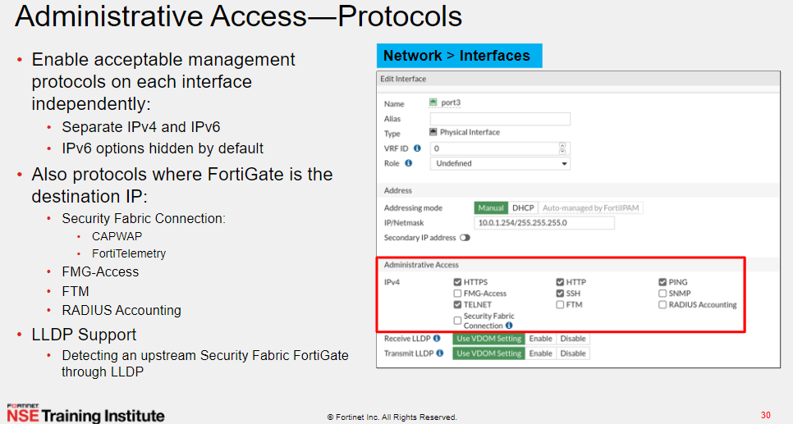
Notes:
https://docs.fortinet.com/document/fhttps://docs.fortinet.com/document/fortigate/7.2.8/administration-guide/574723/interface-settings#Configurortigate/7.2.8/administration-guide/574723/interface-settings#Configur

Slide 52

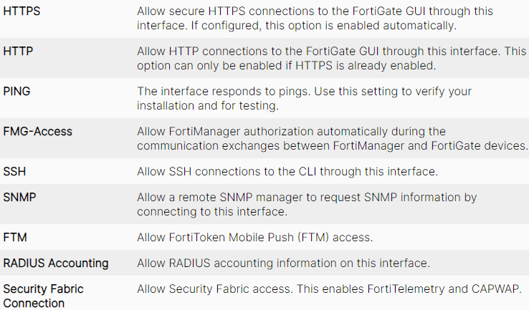
Fortitelemetry is the protocol used for information sharing between Fortinet devices within the security fabric. The security fabric is a way of devices integrating and sharing information to provide a wholistic view of the network and events within it.
For instance, if a user gets an email with zero to Fortisandbox for a ready malware, Fortimail can send the attachment result, Fortisandbox will discover that it is malicious tell the Fortimail to quarantine the file, but then ALSO it will tell every Fortigate and FortiClient in the environment (through Fortitelemetry) about the malicious file, ensuring that the file is quarantined everywhere in the network, even if a user did somehow get the file. You also can setup automated actions, such as quarantining an endpoint if a compromise is discovered, which would take place across the entire fabric, regardless of where the user is located.

Slide 53
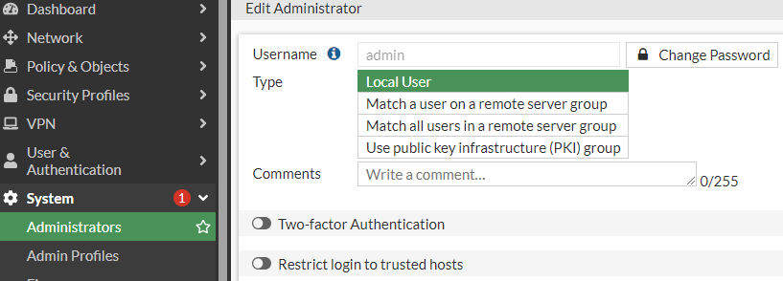
Secure your admin account
Two Factor Authentication
Trusted Host
Notes:
https://www.youtube.com/watch?v=hKX87Kc53NU

Slide 54
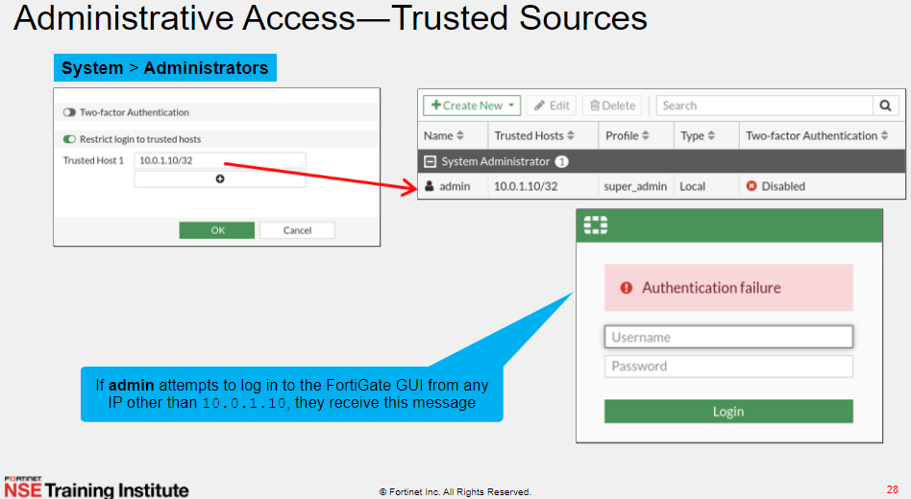

Slide 55
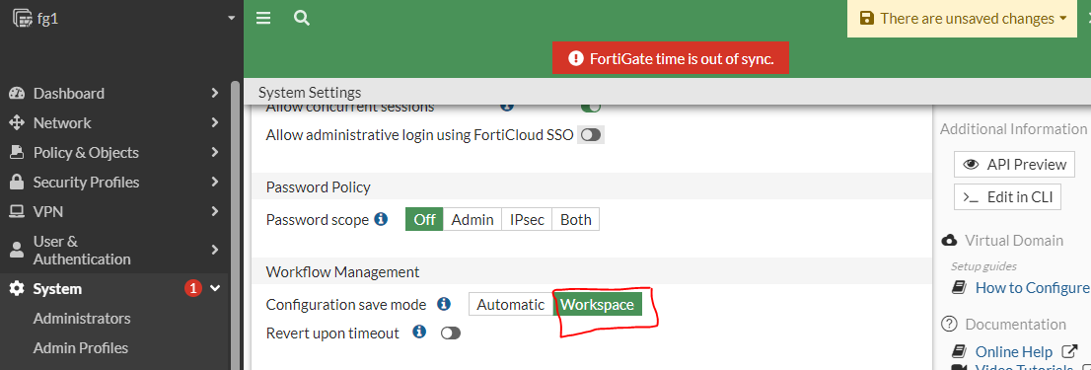
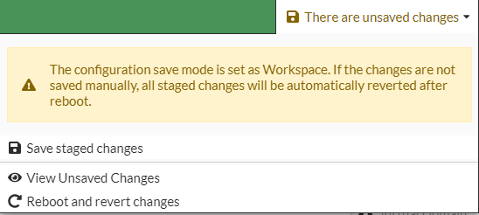
Configuration save mode
Notes:
https://www.youtube.com/watch?v=hKX87Kc53NU

Slide 56

Config sys admin
Edit admin
Set password admin2

Slide 57

Note:
Starting with FortiOS 7.2.4 the maintainer account was removed, meaning this method to reset a password will no longer work. Users must instead have physical access to the FortiGate and perform a TFTP restore of the firmware in order to regain access to the FortiGate.

Slide 58


Slide 59


Slide 60


Slide 61
Interfaces in Transparent Mode
Only configure through CLI
config system settings
set opmode transparent
set manageip <mng_ip>/<netmask>
set gateway <gateway_ip>
end

Slide 62


Slide 63


Slide 64


Slide 65


Slide 66
Aggregation and redundancy
Link aggregation (IEEE 802.3ad) enables you to bind two or more physical interfaces together to form an aggregated (combined) link. This new link has the bandwidth of all the links combined. If a link in the group fails, traffic is transferred automatically to the remaining interfaces. The only noticeable effect is reduced bandwidth.
This feature is similar to redundant interfaces. The major difference is a redundant interface group only uses one link at a time, where an aggregate link group uses the total bandwidth of the functioning links in the group, up to eight (or more).
An interface is available to be an aggregate interface if:
It is a physical interface and not a VLAN interface or subinterface.
It is not already part of an aggregate or redundant interface.
It is in the same VDOM as the aggregated interface. Aggregate ports cannot span multiple VDOMs.
It does not have an IP address and is not configured for DHCP or PPPoE.
It is not referenced in any security policy, VIP, IP Pool, or multicast policy.
It is not an HA heartbeat interface.

Slide 67

Aggregation and redundancy
LACP 802.3ad tra due firewalls fortigate e due nexus in vpc cisco
Notes:
https://www.ingegnerianetworking.com/switching/l2-config/lacp-802-3ad-tra-due-firewalls-fortigate-e-due-nexus-in-vpc-cisco

Slide 68
Interface with reference
You can’t delete any interface reference to route and policy

Slide 69
LAB
Link aggregation between cisco and Fortigate

Slide 70
Cases
Link aggregation between cisco and Fortigate
- Server --→ SW
- SW -→ SW
- Router --→ SW
- FW --→ SW

Slide 71

Vlan Interface (Sub-Interface)

Slide 72

LAB
Use Fortigate as inter vlan routing

Slide 73

FortiLink
FortiLink defines the management interface and the remote management protocol between the FortiGate and FortiSwitch.

Slide 74

Hardware Switch
https://docs.fortinet.com/document/fortigate/7.2.5/administration-guide/100999

Slide 75
Software Switch Switch
https://docs.fortinet.com/document/fortigate/7.2.5/administration-guide/277799/software-switch

Slide 76
Loopback interface
A loopback interface is a logical interface that is always up. Its IP address does not depend on one specific physical port, and the attached subnet is always present in the routing table. Therefore, it can be accessed through several physical or VLAN interfaces.
Typically, a loopback interface can be used with management access, BGP peering, PIM rendezvous points, and SD-WAN.
# use with BGP routing
# Fortigate behind Cisco Router
# public ip subnet

Slide 77

Virtual Wire
# Two interface don’t have IP address and are treated like a similar to transparent mode
# All traffic received by one interface in virtual wire pair can only be forwarded out to other
# need a virtual Wire pair policy
# Virtual Wire Pairing can be used for Fortigate in both the NAT and Transparent
# A virtual wire pair can include redundant and 802.3ad aggregate (LACP) interfaces.

Slide 78

You can also use the one-arm sniffer to configure the FortiGate to operate as an IDS appliance to sniff network traffic for attacks without actually processing the packets. To configure a one-arm IDS, enable sniffer mode on a physical interface and connect the interface to the SPAN port of a switch or a dedicated network tab that can replicate the traffic to the FortiGate.
Traffic scanned on the one-arm sniffer interface is processed by the CPU, even if there is an SPU, such as NPU or CP, present. The one-arm sniffer may cause higher CPU usage and perform at a lower level than traditional inline scanning, which uses NTurbo or CP to accelerate traffic when present.
The absence of high CPU usage does not indicate the absence of packet loss. Packet loss may occur due to the capacity of the TAP devices hitting maximum traffic volume during mirroring, or on the FortiGate when the kernel buffer size is exceeded and it is unable to handle bursts of traffic.

Slide 79


Slide 80

VDOM
Virtual Domains (VDOMs) are used to divide a FortiGate into two or more virtual units that function independently.
By default, most FortiGate units support 10 VDOMs, and many FortiGate models support purchasing a license key to increase the maximum number.
FortiGate-VM V-series, S-series, and Flex-VM instances support split-task VDOMs without any additional VDOM licenses.

Slide 81

VDOM
Routing Table also separated . Interfaces are separated

Slide 82

VDOM : CLI changes

Slide 83

VDOM : administration

Slide 84
VDOM : use cases
physical FortiGate unit requires a FortiGuard license to access security updates. VDOMs do not require any additional FortiGuard licenses, or updating — all the security updates for all the VDOMs are performed once per update at the global level
Fw as a service
Edge and DC FW at the same Hardware
NAT and Transparent

Slide 85

How to Configure Inter-VDOM links

Slide 86


Slide 87


Slide 88


Slide 89
LAB
DHCP relay

Slide 90


Slide 91


Slide 92


Slide 93


Slide 94


Slide 95


Slide 96


Slide 97
Restore config
Should use the same model

Slide 98
Restore config
With vdom

Slide 99
Fortigate Auto backup script
config system auto-script
edit backup
set interval 120
set repeat 0
set start auto
set script “execute backup config tftp backup5.conf 192.168.1.1 “
end
Notes:
https://community.fortinet.com/t5/FortiGate/Technical-Tip-Automated-script-execution/ta-p/193685
https://docs.fortinet.com/document/fortigate/7.0.1/administration-guide/780930/configuration-scripts
https://docs.fortinet.com/document/fortigate/7.0.1/administration-guide/530847/workspace-mode

Slide 100
Automatic Configuration Backup after each logout
FW# config system global FW# set revision-backup-on-logout enable FW# end
Notes:
https://itadminguide.com/fortigate-cli-commands-for-troubleshooting/

Slide 101


Slide 102

With VDOM

Slide 103


Slide 104
Upgrade best practice procedure
- Always read the release note
- Take Backup
- Some issues with upgrade :
Loss connection with FortiAP
Loss connection with FortiSwitches
SDWAN between 6.2 and 6.4
Keep copy of config file for the current version
Log in at support.fortinet.com and select the Firmware Images Make sure to download the firmware corresponding to your device model
- Follow upgrade path
- Connect console to see consul errors

Slide 105
HA Cluster
FortiGates in the cluster must be the same model and have the same firmware installed. Cluster members must also have the same hardware configuration (such as the same number of hard disks) , also same licenses .
The following are critical components in an HA cluster:
Heartbeat connections: members will use this to communicate with each other. In general, a two-member cluster is most common. We recommend double back-to-back heartbeat connections.
Identical connections for internal and external interfaces: as demonstrated in the topology, we recommend similar connections from each member to the switches for the cluster to function properly.
best practices for general cluster operation:
Ensure that heartbeat communication is present.
Enable the session synchronization option
Monitor traffic flowing in and out of the interfaces.

Slide 106

HA Cluster

Slide 107
HA Cluster: failover protection
FGCP provides failover protection in the following scenarios:
The active device loses power.
A monitored interface loses a connection.
Optionally, if an SSD fails, it can automatically fail over to a backup unit
To enable an SSD failure triggering HA fail over:
config system ha
set ssd-failover enable
end

Slide 108


Slide 109


Slide 110
Upgrade with HA Cluster
To upgrade the cluster firmware without interrupting communication, the following steps are followed. These steps are transparent to the user and the network, and might result in the cluster selecting a new primary unit.
The administrator uploads a new firmware image using the GUI .
The firmware is upgraded on the subordinate unit.
A new primary unit is selected from the upgraded subordinate.
The firmware is upgraded on the former primary unit.
Primary unit selection occurs , according to the standard primary unit selection process.
If all of the subordinate unit crash or otherwise stop responding during the upgrade process, the primary unit will continue to operate normally, and will not be upgraded until subordinate rejoins the cluster.

Slide 111
Migration config from model to model
edit the first line as new model
For example : #config-version=FG201E-6.4.0-FW-build1579-200330:opmode=0:vdom=0:user=admin
Change the interfaces number if needed through notepad++

Slide 112


